Slide 1
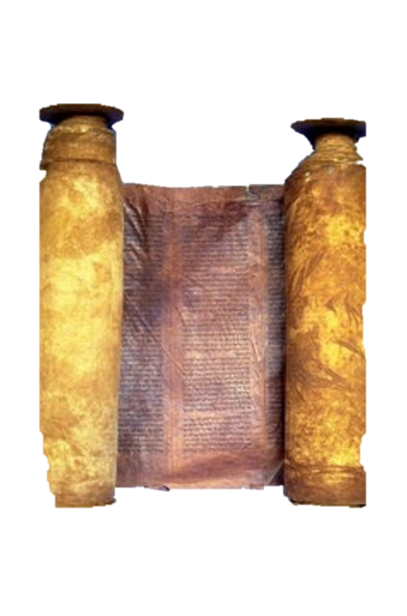
A free CD of this message will be available immediately following the service
1 Kings
6-8
A podcast will also be available later this week at calvaryokc.com

Slide 2
Spring 967 BC (Exodus was 1447 BC)
1 kings 6-8

Slide 3
1 kings 6-8

Slide 4
90' X 30' X 45' (2,700 sq. ft.)
1 Chr. 28:19 ~ "All this," said David, "the Lord made me understand in writing, by His hand upon me, all the works of these plans."
1 kings 6-8

Slide 5
1 kings 6-8

Slide 6
Theodoret and Procopius ~ it was a miracle - the stones came out of the rock bed already shaped
One tradition: Stones shaped themselves
Another tradition ~ magic worm (shamir) cut and shaped the stones
1 kings 6-8

Slide 7
1 kings 6-8

Slide 8
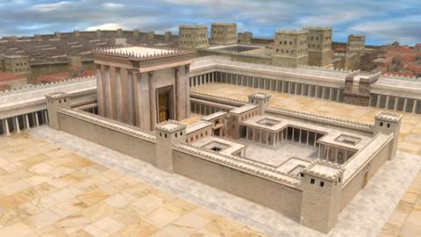
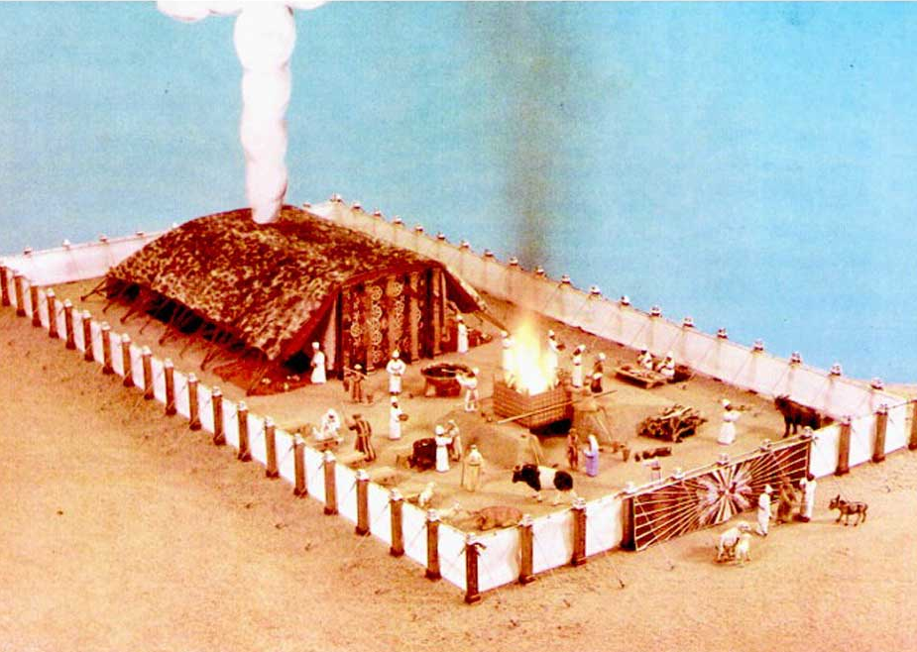
1 kings 6-8

Slide 9
1 kings 6-8

Slide 10
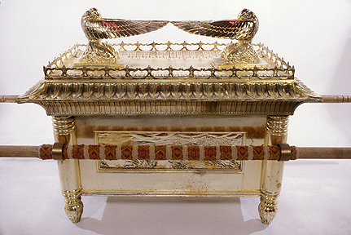
1 kings 6-8

Slide 11
1 kings 6-8

Slide 12
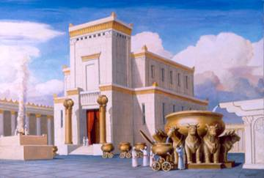
Boaz ~ In Him is Strength
Jachin ~ He Establishes
1 kings 6-8

Slide 13
1 kings 6-8

Slide 14
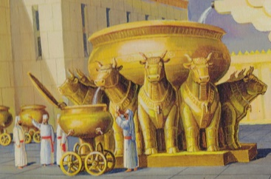
15’
7.5’
1 kings 6-8

Slide 15
Sea ~ yam – a body of water
1 kings 6-8

Slide 16
1 kings 6-8

Slide 17
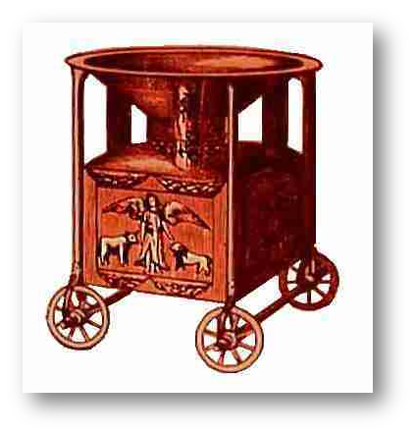
1 kings 6-8

Slide 18
1 kings 6-8

Slide 19
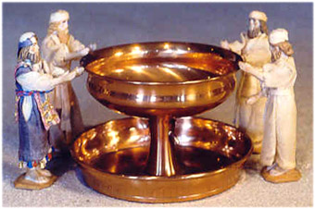
1 kings 6-8

Slide 20
1 kings 6-8

Slide 21
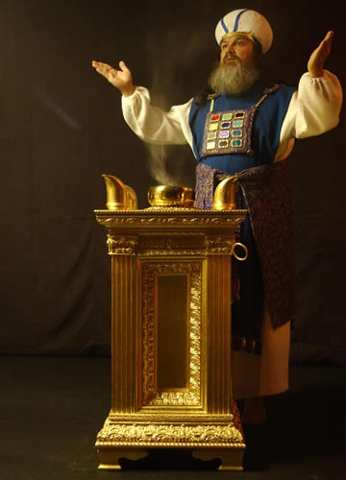
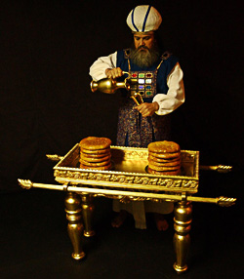
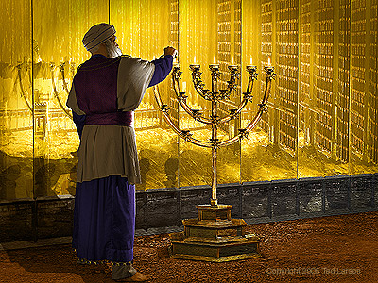
1 kings 6-8

Slide 22
1 kings 6-8

Slide 23
Loyal ~ KJV, perfect – shalem
2 Chr. 7:1 ~ When Solomon had finished praying, fire came down from heaven and consumed the burnt offering and the sacrifices; and the glory of the Lord filled the temple.
1 kings 6-8

Slide 24
1 kings 6-8

